Slide 1
IAS – Amsterdam, july 24th, 2018
HIV Viral Load technologies:
Which solution for which context?
Pr Christine ROUZIOUX
CHU Necker – EA 7327 Université Paris Descartes
With many thanks to the OPP-ERA teams, especially Pr B. Coriat & Dr N. Yakhelef
No confict of interest

Slide 2
Introduction
The reality is that we are far from the 4.5 millions Viral Load tests that are needed for West Africa. There is still a long way to go, before reaching ‘the third 90’.
There is no ONE solution and experiences in high prevalence countries can’t be the only model to follow.
Some parameters to choose a system include at least:
The country prevalence (impact on the throughput)
The laboratory level (national, regional, rural),
Needs for other markers such as TB, HBV, HCV
The challenge is to find tailored solutions and facilitate innovation.

Slide 3
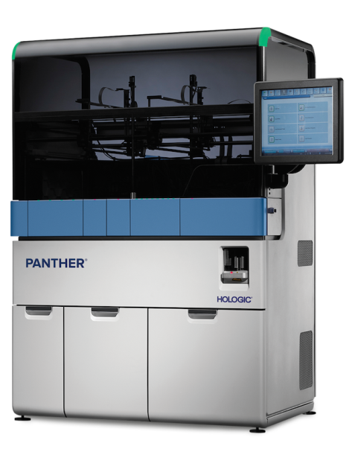
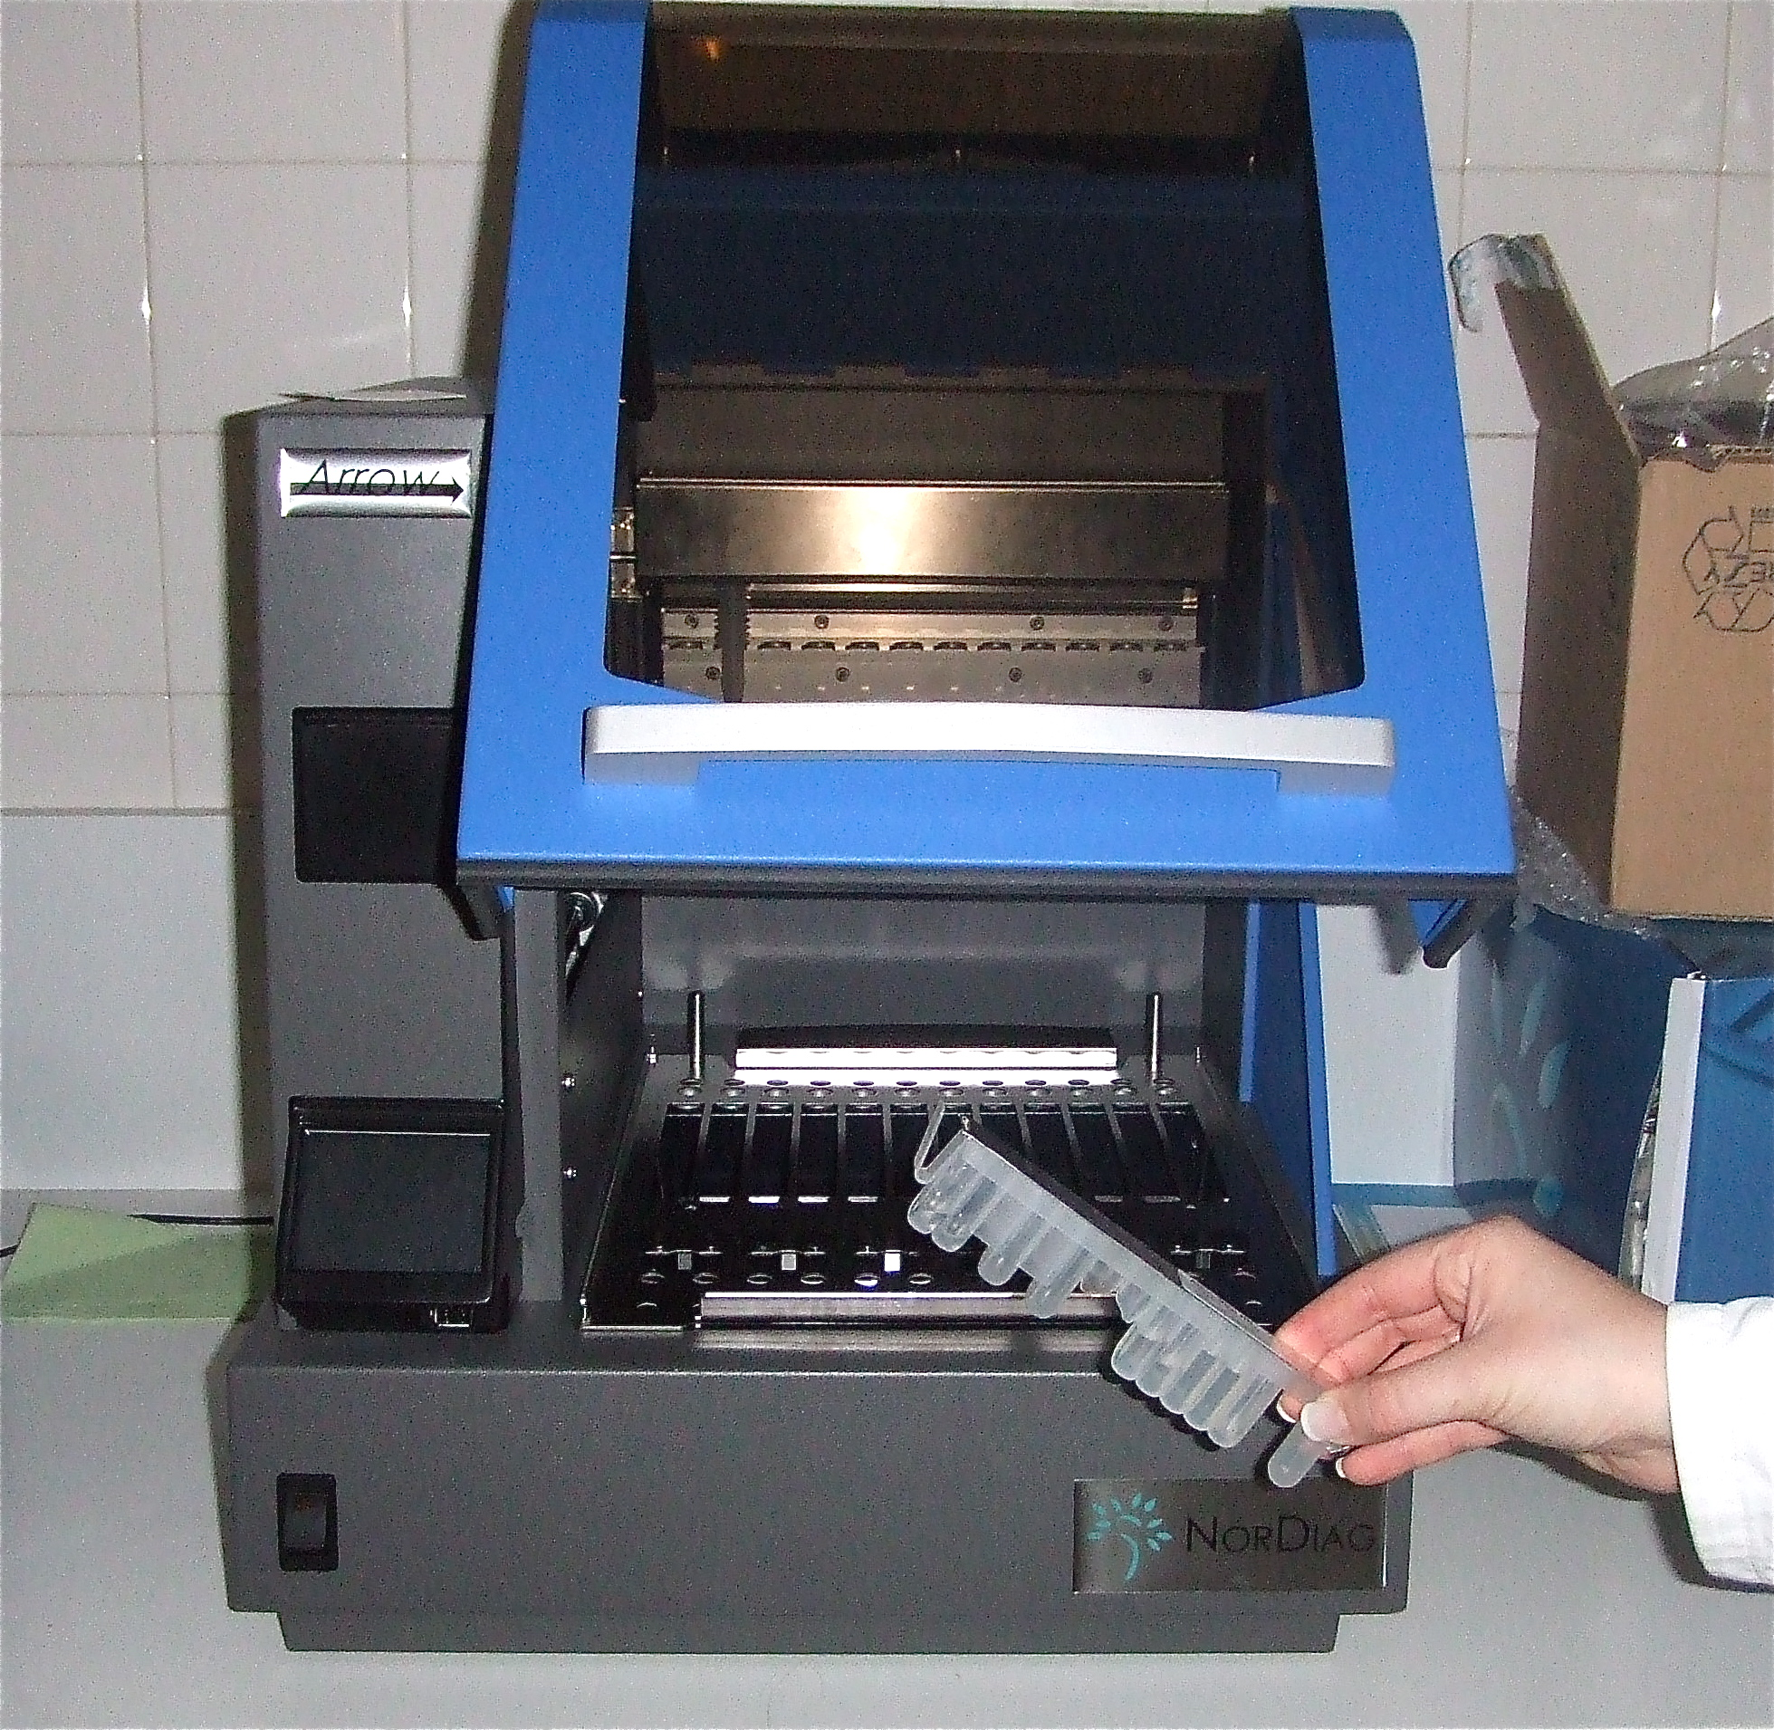
Innovation: technological advances
Innovation within the 3 systems:
Integrated/Closed systems: ex HOLOGIC (TMA), VERIS:
- sample random access, use of primary samples
- HIV, HBV, HCV the same day
OPP: Association of 3 elements: extractor, reagents and PCR machine:
ex: new PCR machines well adapted:
- with intuitive software, more adapted to medical laboratories,
- automated interpretation of the results (Resist. TB)
- barcode for samples, to avoid mistakes of transcription….
POC: ex Genexpert: multiples channels : 1, 2, 4, 16
Polyvalence with reagents for HIV-1 VL, TB and EID
Chemistry innovation: → Research continues
- New enzymes and new Mix,
- Lyophilyzed reagents (no need for cold chain)
- Efficient nucleic acid extractions… (yield)

Slide 4
The concept of « Open » systems progresses
Some Integrated/Automated systems are now OPEN:
Ex : BD Max, : open to various reagents from other suppliers,
open to built partnership with reagent suppliers.
Open Polyvalent Systems:
Several combinations of machines and reagents are now possible:
Ex: several NA extraction machines : Diasorin, Promega , Roche…
several PCR machines: Fluorocycler, Quant Studio X5, Lightcycler…
Polyvalence: various reagent providers for TB, (Hain, Anyplex, Diagenode…). Reagents available on different OPP, Idem for HBV, HCV reagents.
There are new possibilities, new solutions.
Manufacturers must be encouraged to enter new alliances.

Slide 5
The systems’ complementarity
Three Viral Load systems
HIV, TB, HBV, HCV
Integrated/Closed
Systems
High throughput
OPP
High and medium
throughput
POC
low throughput
Various Laboratory levels
Regional
Lab
Rural
EID/TB
National
Lab
Multiples combinaisons (HIV-TB) could be adapted to level’s Lab

Slide 6
Whatever the technique,
enabling lab environment is essential
Technicians must know how to receive, register and prepare plasmas, reagents and manage the organization of a medical laboratory :
Waste management (cyanide coming from extraction reagent)
Cold chain storage
Stock management
Machines Maintenance…
Internal and External Quality assessments
Technicians and biologists training,
Relationship with Physicians
The problem of human resources is recurent
and have an important impact on the quality of the results

Slide 7
To conclude
Many innovative technical advances should help to put the right machines in the right places.
The best choice is not a single supplier per country, but a selection of systems according to the level of local labs and the number of tests/year.
Complementarity of different offers:
Need to facilitate the entrants arrival and the prequalification of new machines and new open combinations:
All these advances could benefit patients and physicians,
while improving the quality and reliability of the VL results.

